Slide 1

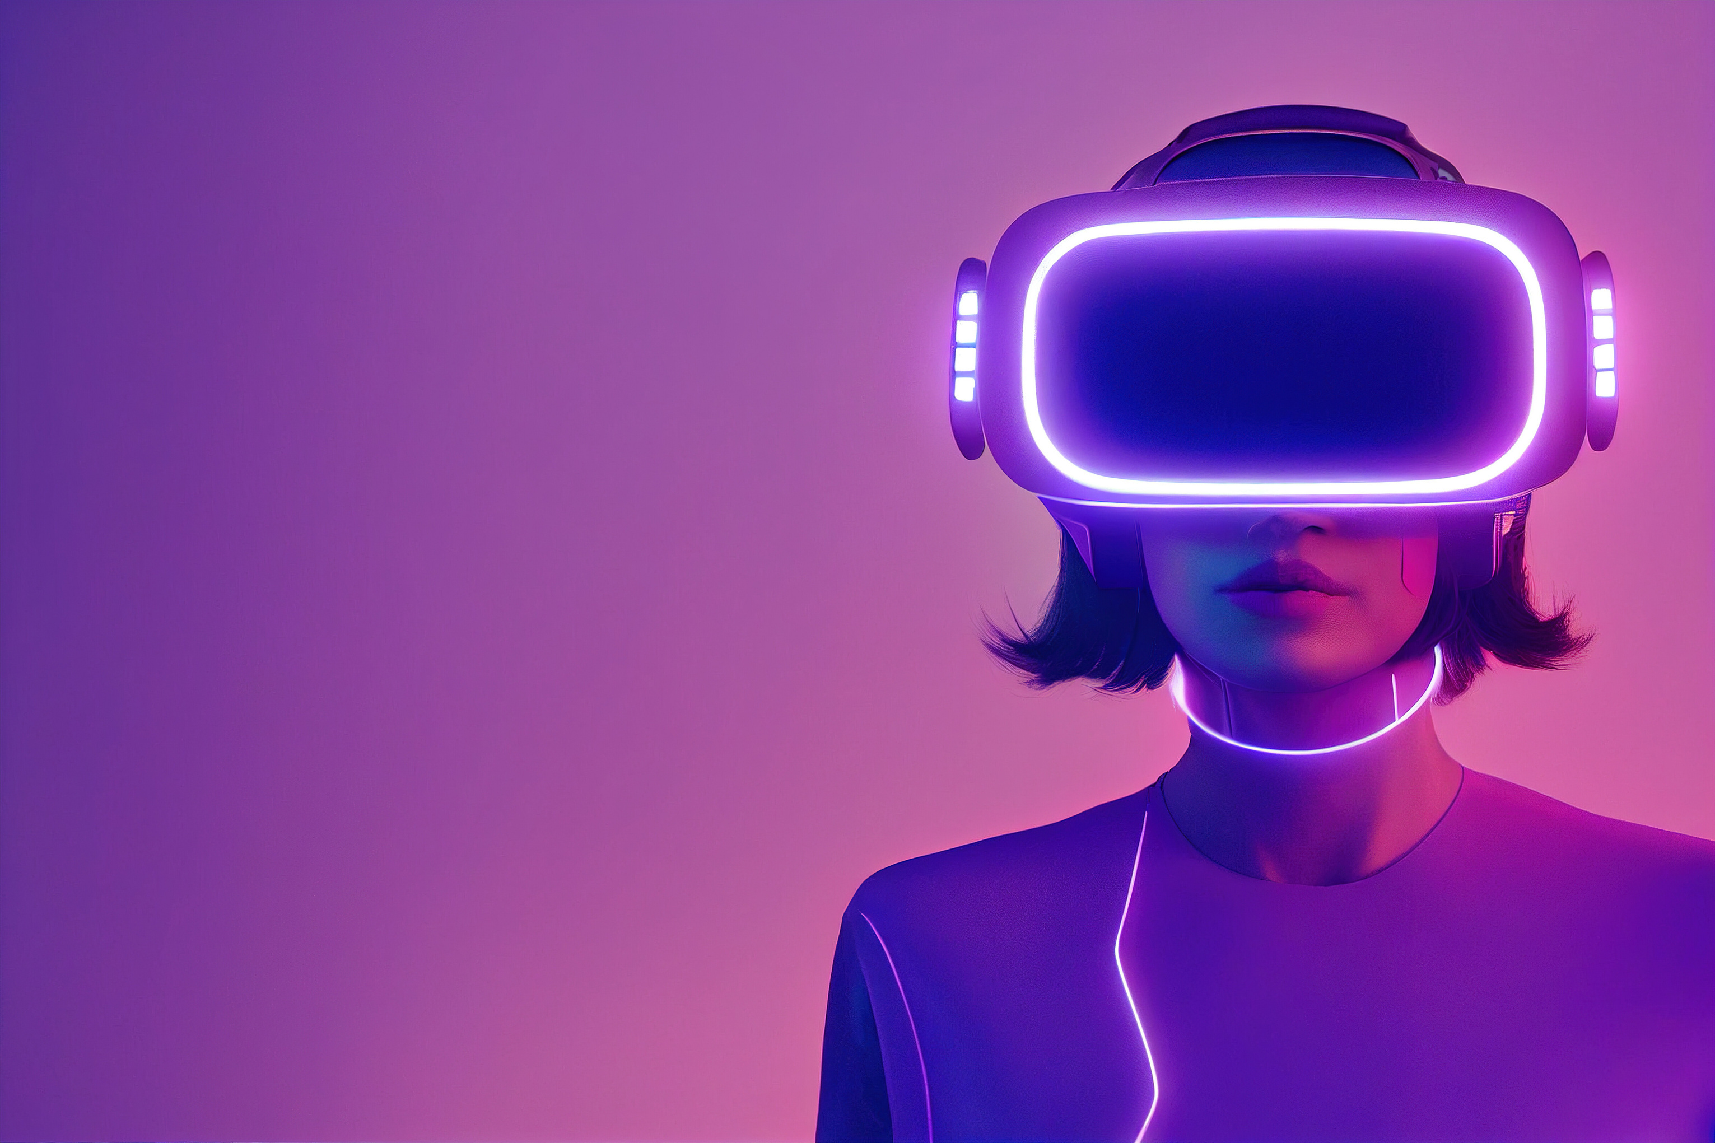
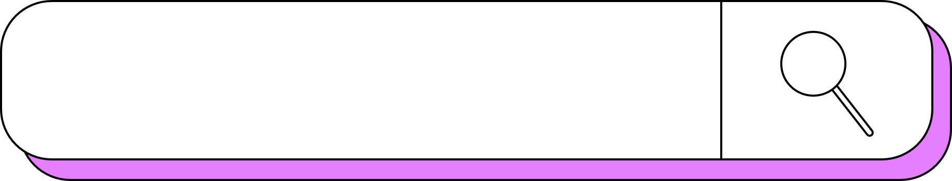
virtual
MOUSE
Let’s start!
Presented by HITESH DEWANGAN

Slide 2


ATAL BIHARI VAJPAYEE VISHWAVIDYALAYA, BILASPUR
PRESENTATION ON
VIRTUAL MOUSE USING HAND GUESTURE
GUIDED BY
Dr. H.S HOTA
PRESENTED BY
HITESH DEWANGAN

Slide 3
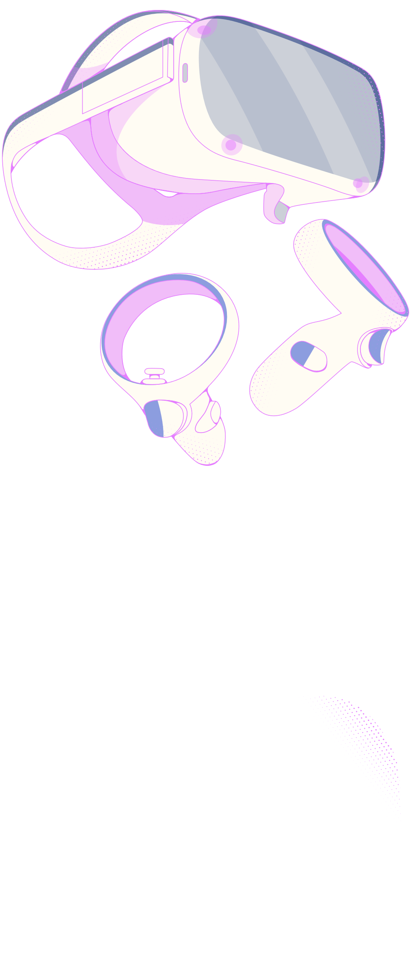

contents
1
Introduction
6
2
Features
Objective
7
3
Applications
Libraries Used
8
4
Future work
System Architecture
9
5
Conclusion
Flow Chart

Slide 4
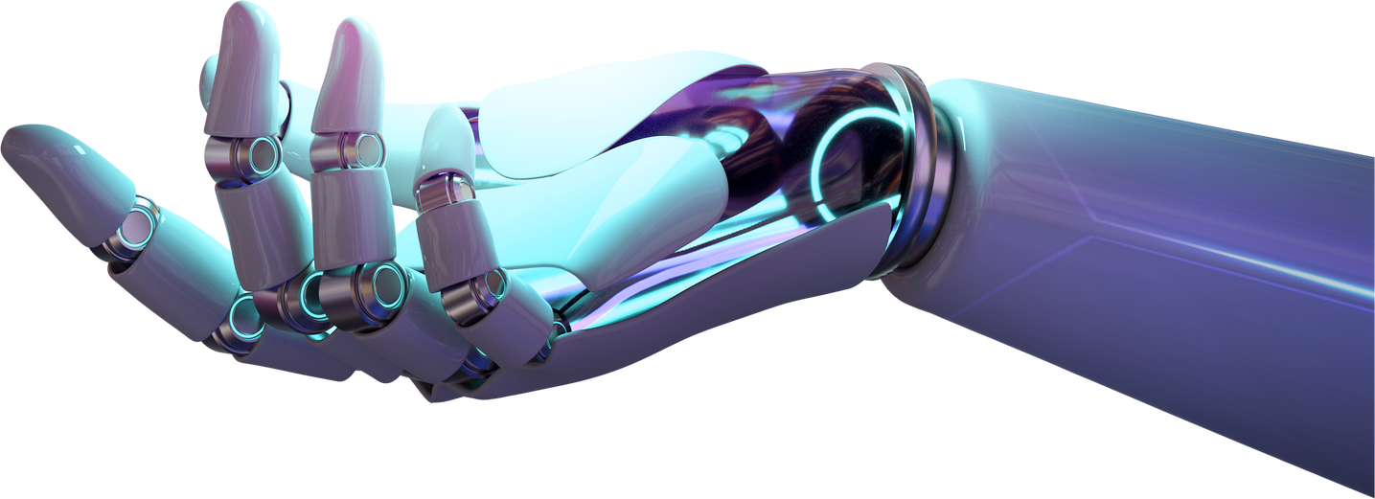
introduction
A virtual mouse is a system that allows users to control a computer cursor using hand gestures instead of a physical mouse. This project leverages computer vision and machine learning to detect and interpret hand gestures, enabling seamless interaction with the computer.

Slide 5
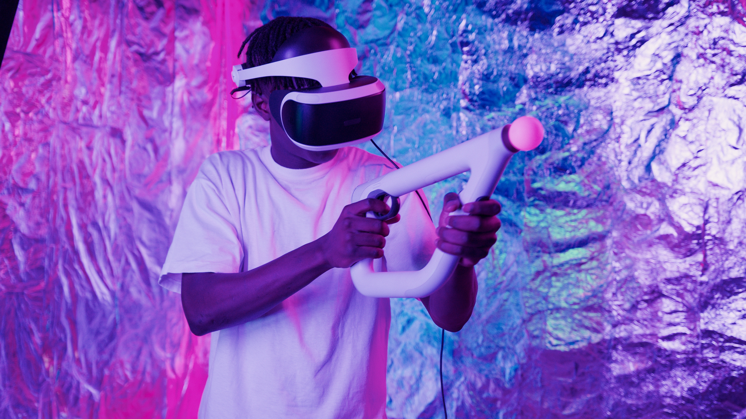
Objective
The primary objective of the "Virtual Mouse Using Hand Gestures" project is to develop an intuitive and efficient user interface that allows individuals to control their computers through hand gestures.

Slide 6
Libraries Used
OPENCV
MEDIAPIPE
UTIL
PYAUTOGUI
Library For Real-time Computer Vision Tasks. Used For Capturing And Processing Video Frames
Library For Gui Automation. Facilitates Mouse Movement And Clicks Based On Detected Hand Gestures.
Custom Utility Functions For Calculating Angles And Distances Between Hand Landmarks
Utilized For Detecting Hand And Plotting Landmarks

Slide 7
system architecture
HAND DETECTION
LANDMARK PLOTING
GESTURE RECOGNITION
ACTION EXECUTION
Ploting Landmarks Using
Hand Landmark Model
Recogniting Gesture By Calculating Angles Between Landmarks
Detecting Hand Using Palm Detection Model
Executing Actions

Slide 8
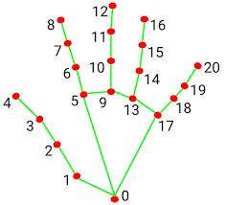
Landmark points of Hand

Slide 9
FLOWCHART

Slide 10
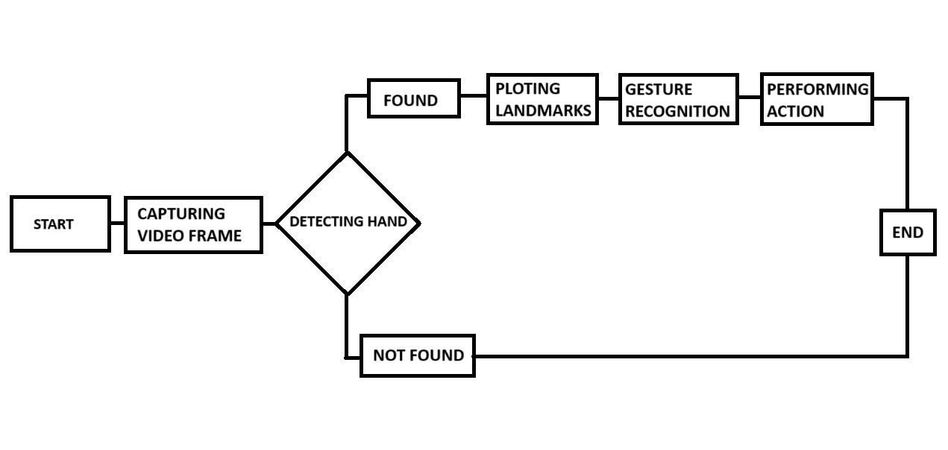

Slide 11
FEATURES

Slide 12
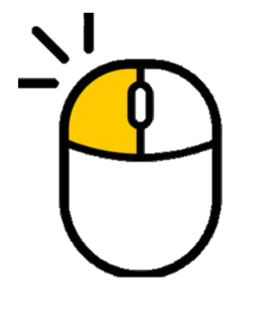
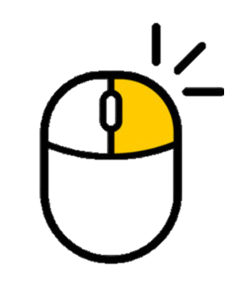
LEFT CLICK
RIGHT CLICK

Slide 13
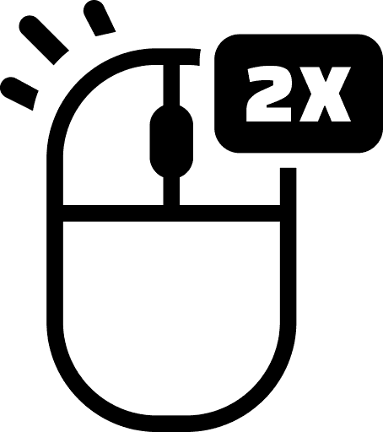

DOUBLE CLICK
DRAG AND DROP

Slide 14


VOLUME UP
VOLUME DOWN

Slide 15


BRIGHTNESS UP
BRIGHTNESS DOWN

Slide 16
APPLICATIONS

Slide 17
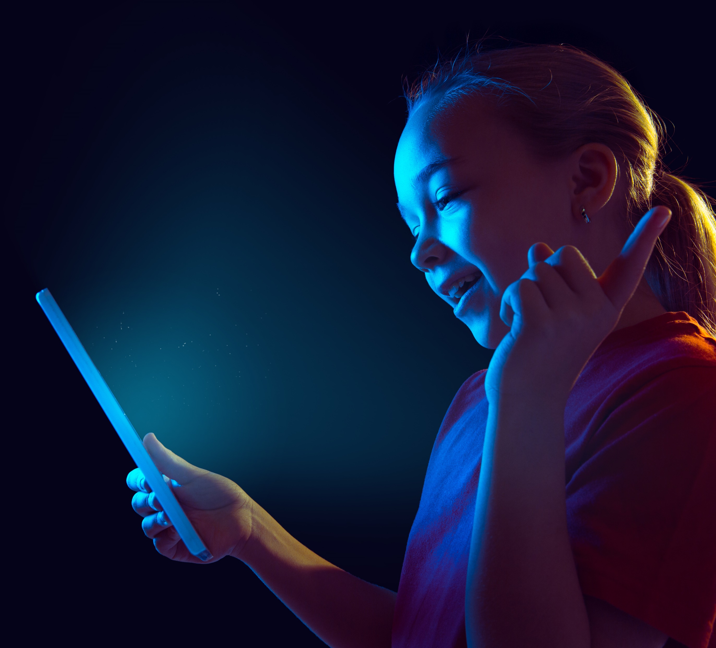
1
Education
Teachers can use gestures to interact with digital whiteboards or presentations.

Slide 18
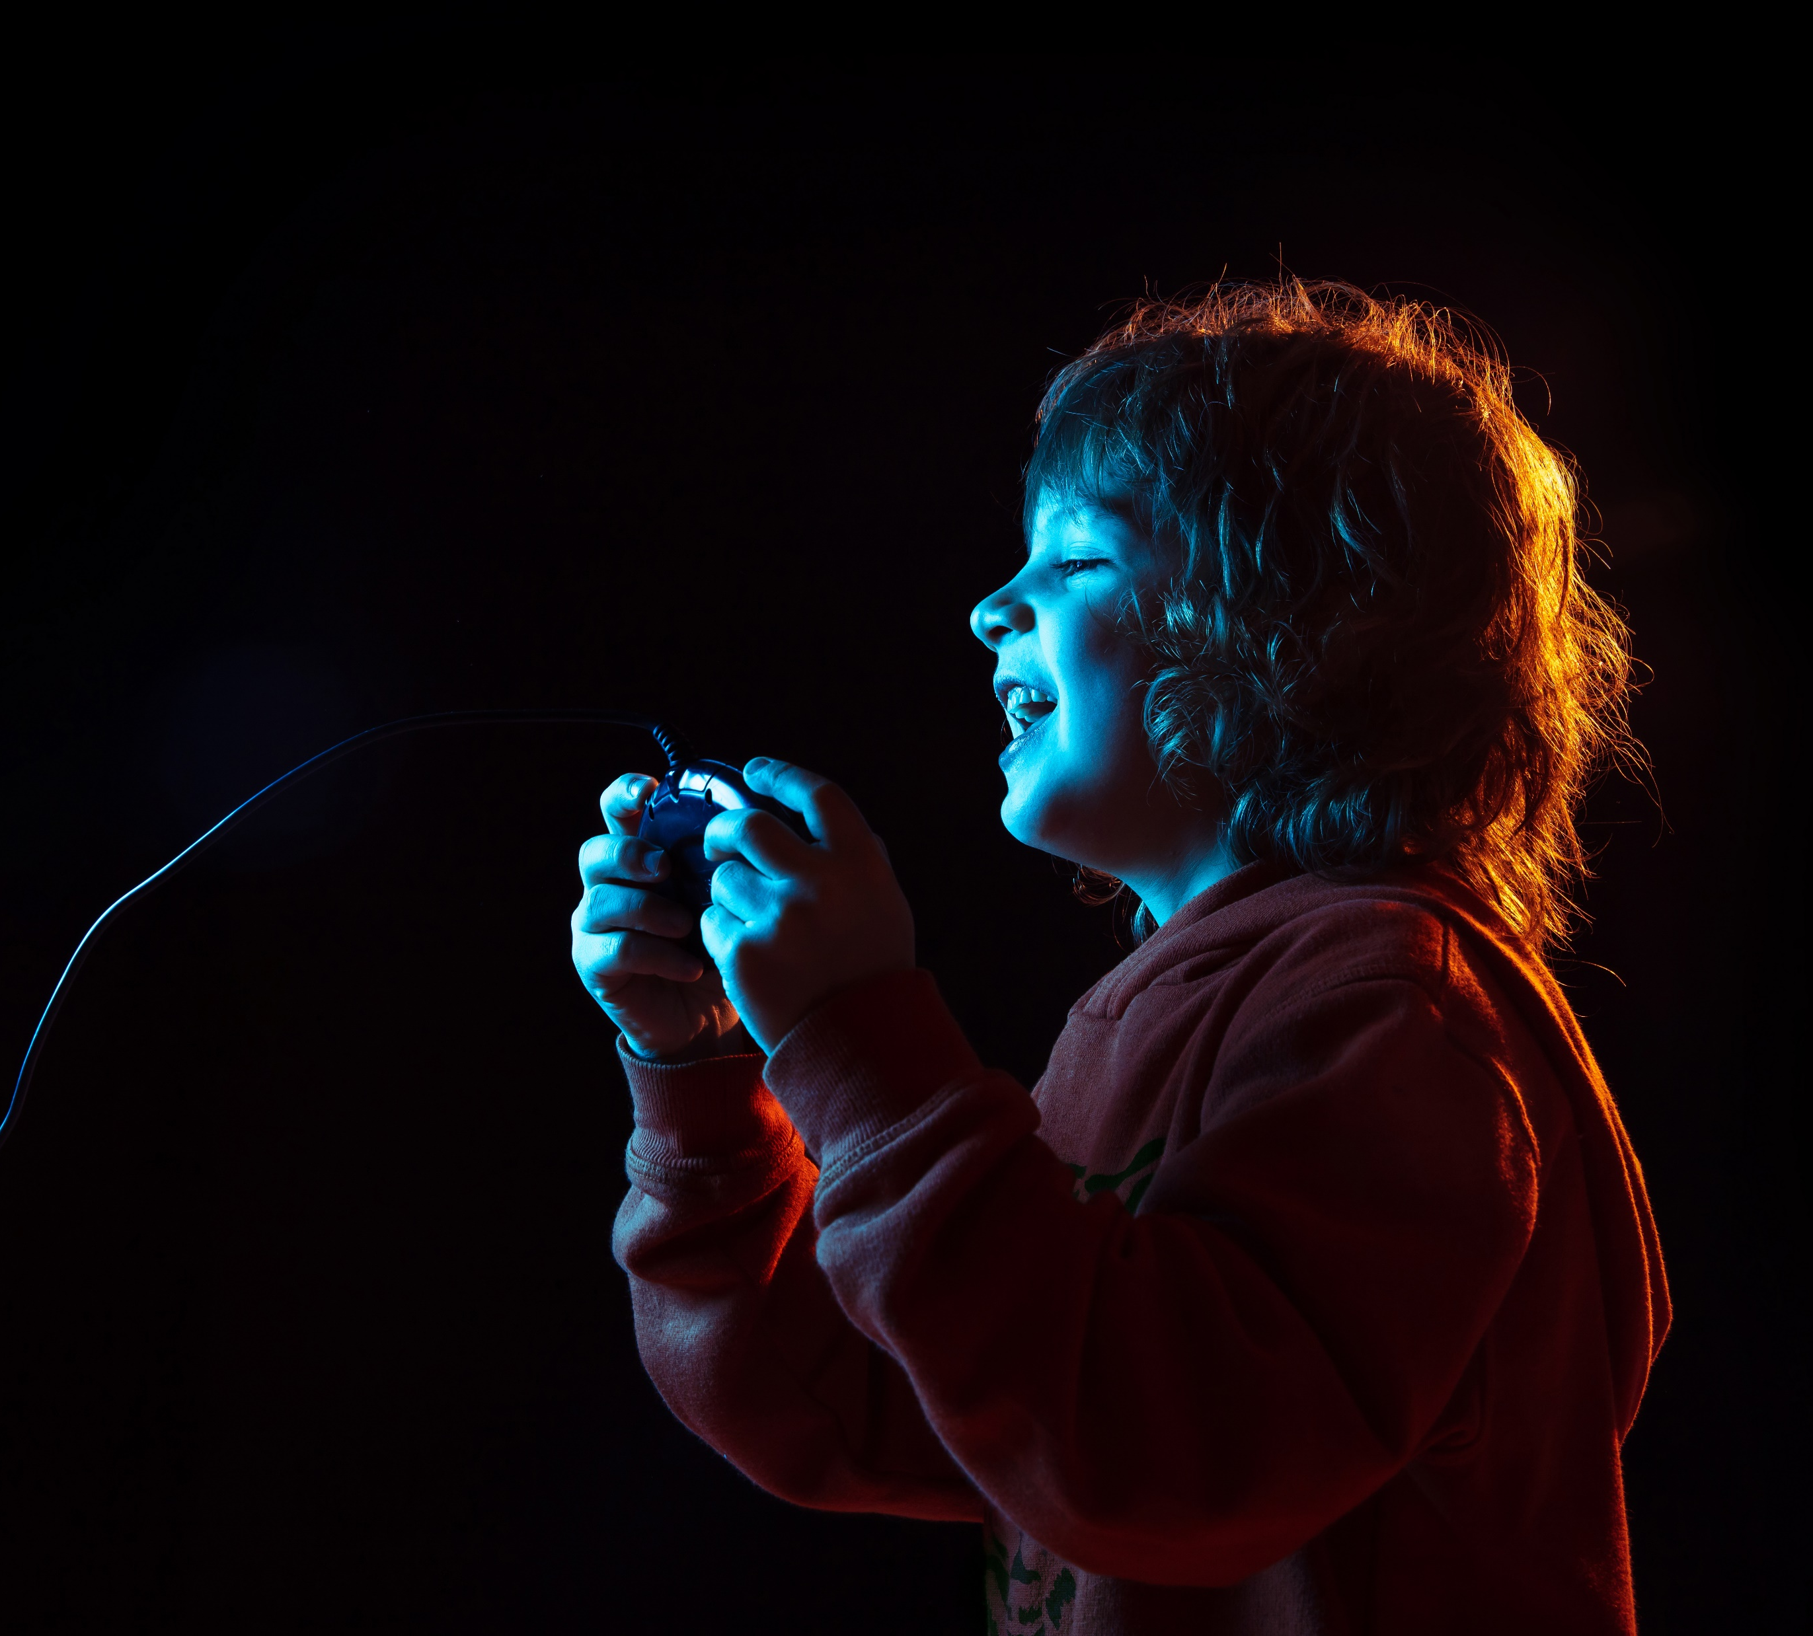
2
Gaming
Using hand gestures to interact with games for a more immersive experience.

Slide 19

3
Healthcare
Surgeons can control computers in sterile environments without touching them.

Slide 20
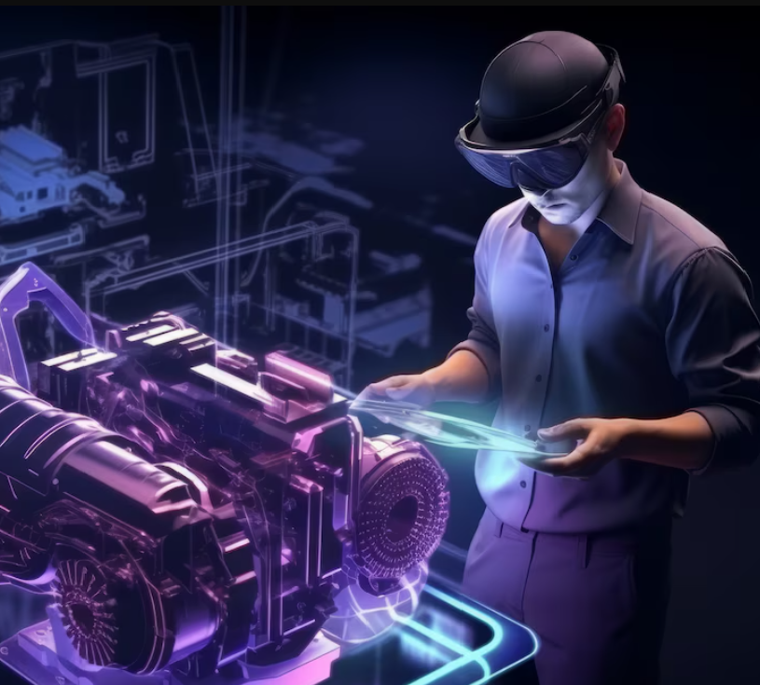
4
Industry
Workers can control machinery or computers in environments where touching devices is impractical.

Slide 21
future Work
Support for multi-hand gestures.
Integration with other input devices.
Expanding gesture library for more actions.
Decreasing response time.

Slide 22
CONCLUSION
Developed a functional virtual mouse system using hand gestures.
Implemented key features like cursor movement and various mouse actions.
Demonstrated the potential of computer vision and machine learning in enhancing human-computer interaction.

Slide 23
Thank
you!

